Slide 1






Concept Design Review
Group 4
Bellamy Woo Zhen Yu 2301579
Chai Ze Xuan 2301629
Low Min Wei 2301555
Muhammad Ariff (Project Lead) 2301644
Shaun Ong Zhi Peng 2301632

Slide 2
TABLE OF CONTENTS
Design Goals and System Requirements
Gripper Design Concepts
Concept 1
Concept 2
Concept 3
Supporting Frame Concepts
Concept 1
Concept 2
Selection of Product
Gripper Selection
Frame Selection
Design Analysis
BOM Lists
Fabrication Methods
Q&A
2/20

Slide 3

Design Goals
Main Goal
Design a gripper that can securely hold onto the trolley during navigation.
Gripper System Requirements
The system shall be able to grip trolley with a strength of 20 kg.
The system shall be able to let go of trolley.
The system shall be able to withstand turning forces.
The system shall be able to handle minor vibrations during movement of the trolley.
The system shall be able to withstand weight of trolley.

Slide 4


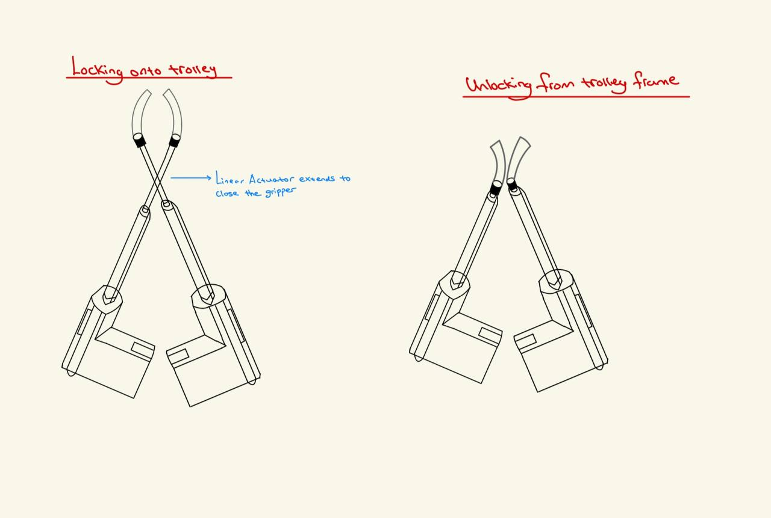
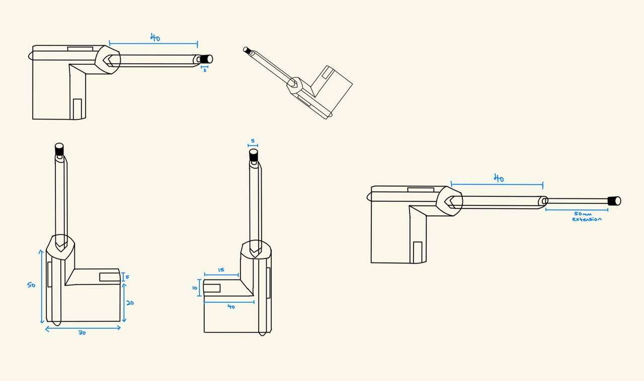

Gripper Design Concept
Concept 1
Linear Actuator Gripper Design
Gripper placed at ends of the actuator
Extension of linear arm will grip onto trolley frame
Retraction of arm will disengage the gripper from trolley frame

Slide 5
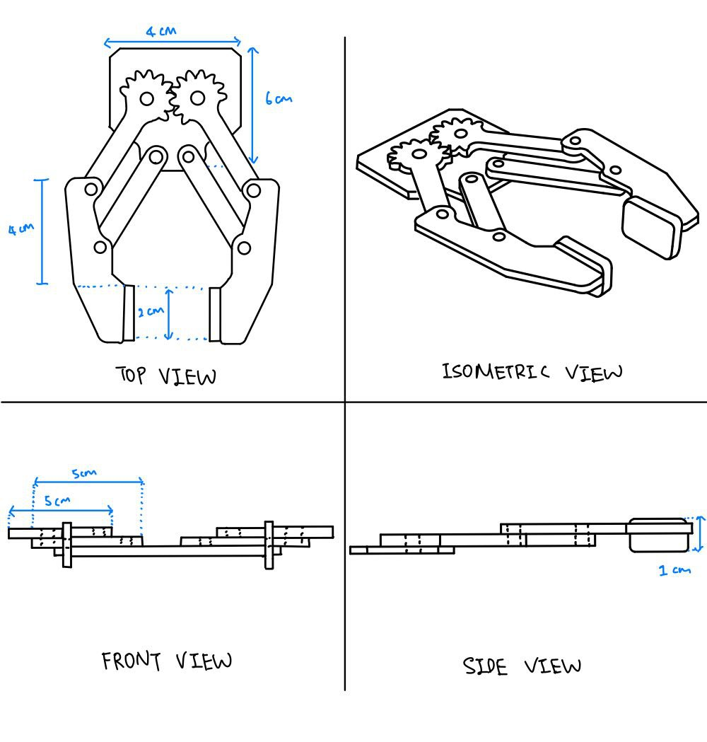
Gripper Design Concepts
Concept 2
2 Moveable Jaw Design
2 half-gear interlock
Servo connects to one of the gear
Gripper able to close and secure trolley frame

Slide 6
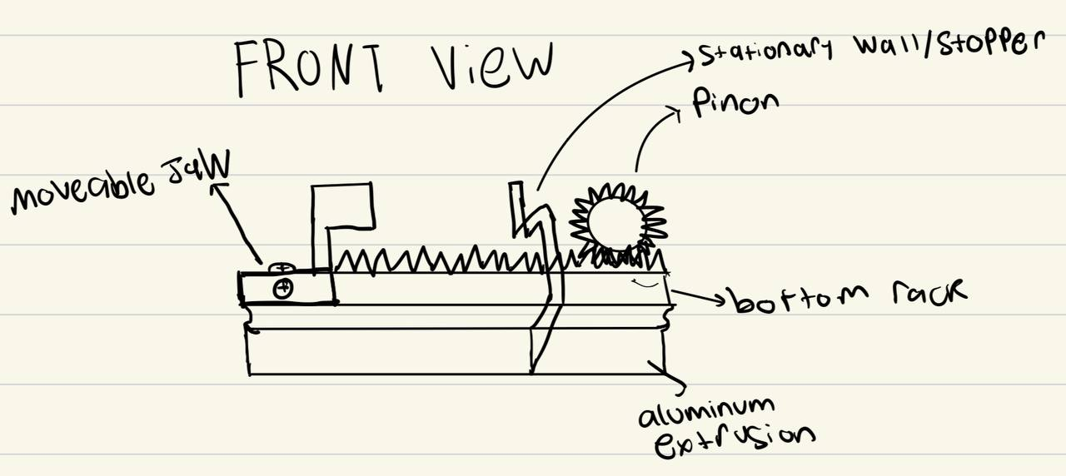
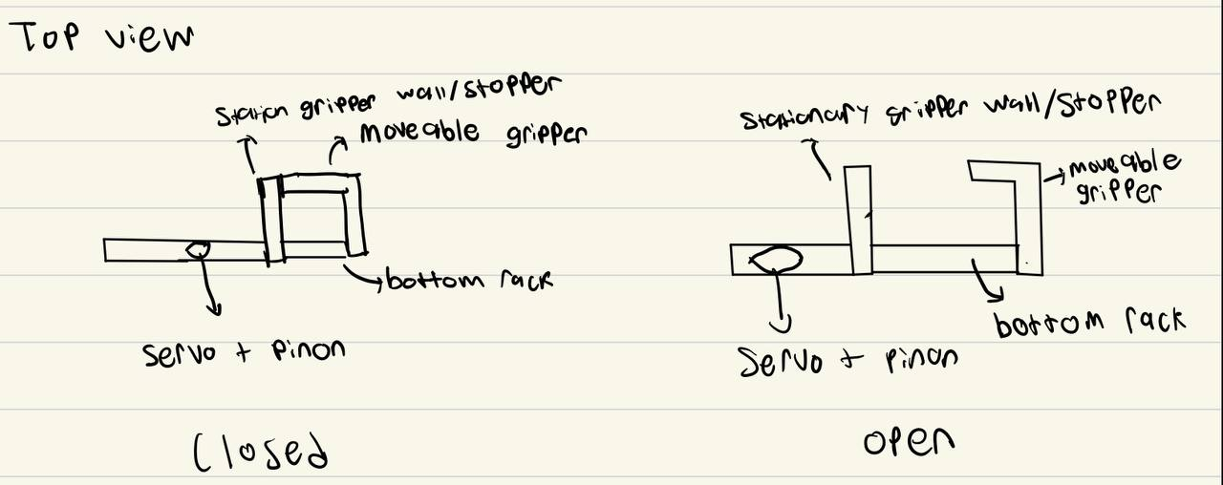

Gripper Design Concepts
Concept 3
Front view
Top view
Rack and Pinion mechanism moves the bottom rack
Rack and Pinion positioned at the end to allow for larger opening
One dead jaw and one movable jaw
Moveable Jaw mounted on 2 surfaces (Top and Front)
Notes:
Servo and pinon positioned at the end to allow for smaller closing distance
Added function to stationary wall to boost compactness

Slide 7
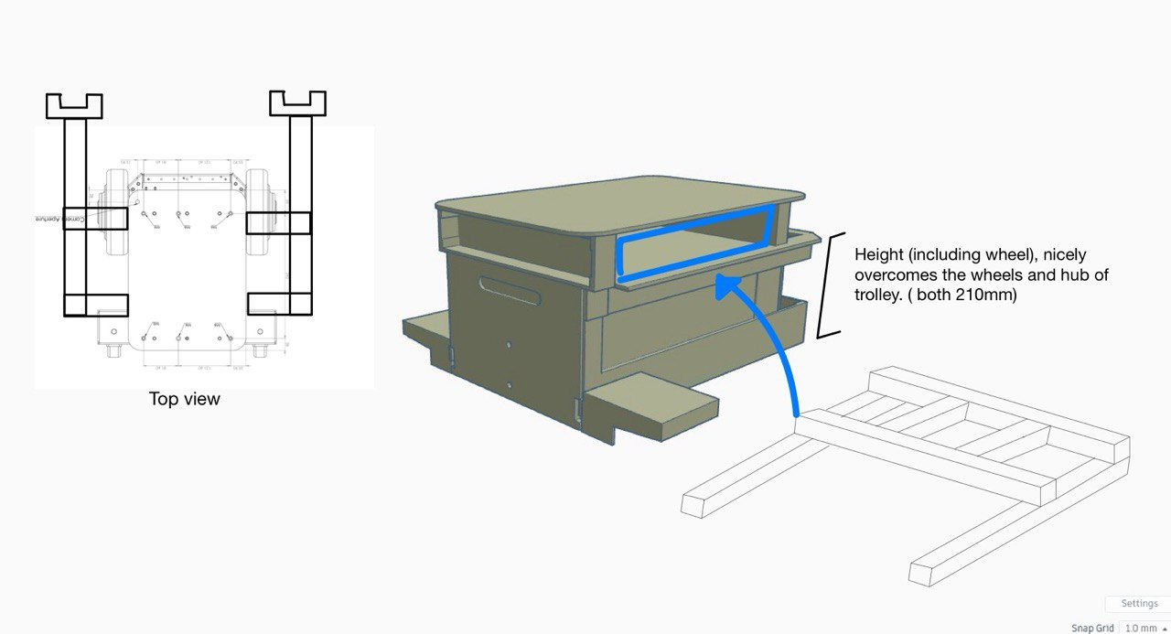
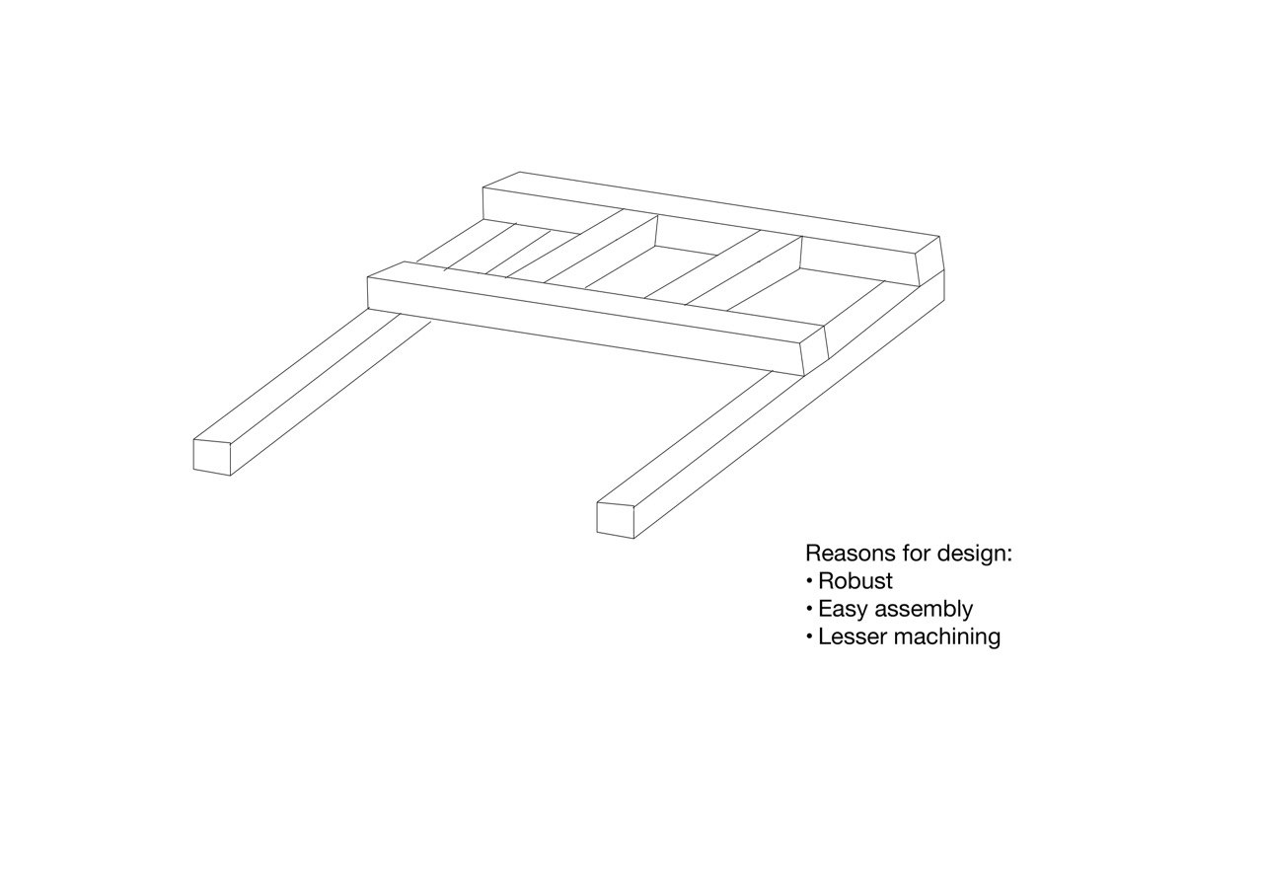
Supporting Frame Concept
Concept 1
Grippers are attached to the bottom row of the vertical aluminum rods
Lesser Machining (made out of aluminum extrusions)
Easy Assembly
Robust

Slide 8
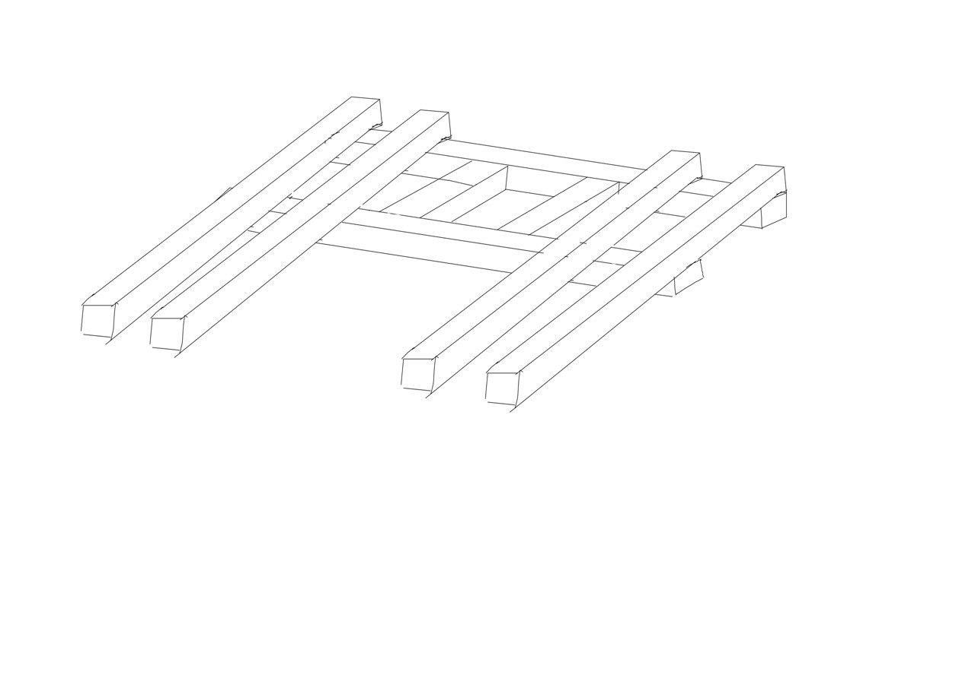
Supporting Frame Concept
Concept 2
Grippers are attached to the end of the vertical rods
Utilizes all of the AMR’s mounting holes for more load distribution
Additional row of rod on each side of the AMR for additional support of the gripper
Corner bracket on each intersecting rods to strengthen the supporting frame

Slide 9


Gripper Selection
Selected Design
Rack and Pinion
Reasons for selection
No back drive to motor
High strength to withstand turning force
Highest simplicity to value ratio
Decreased chances of breaking

Slide 10
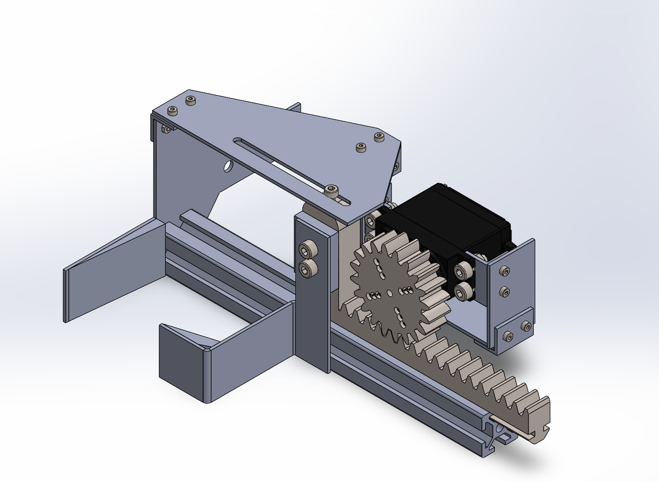
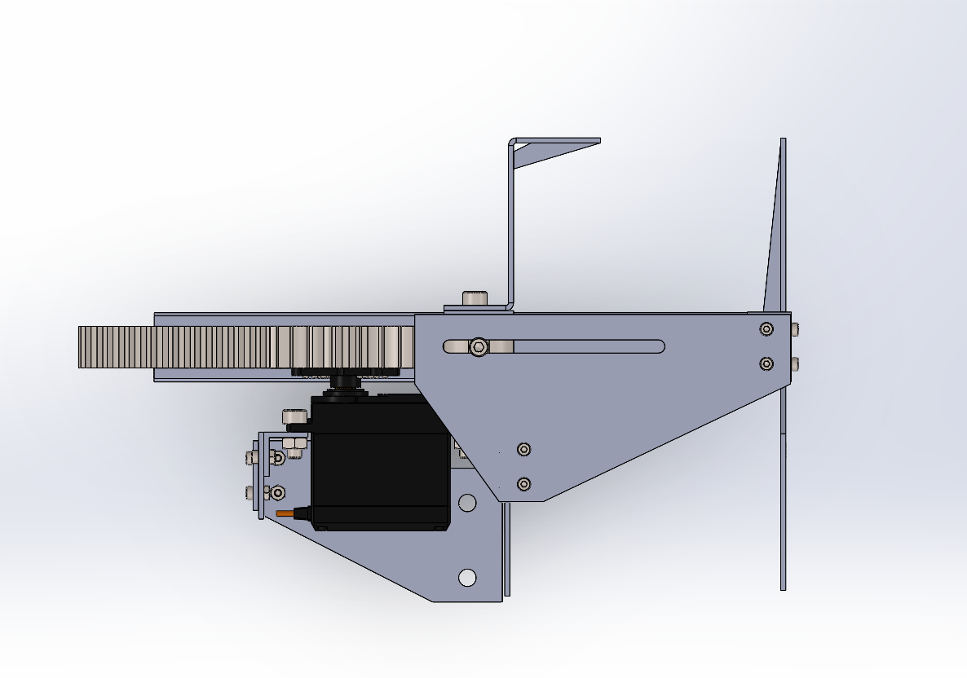
Final Gripper CAD
Isometric view
Top view

Slide 11
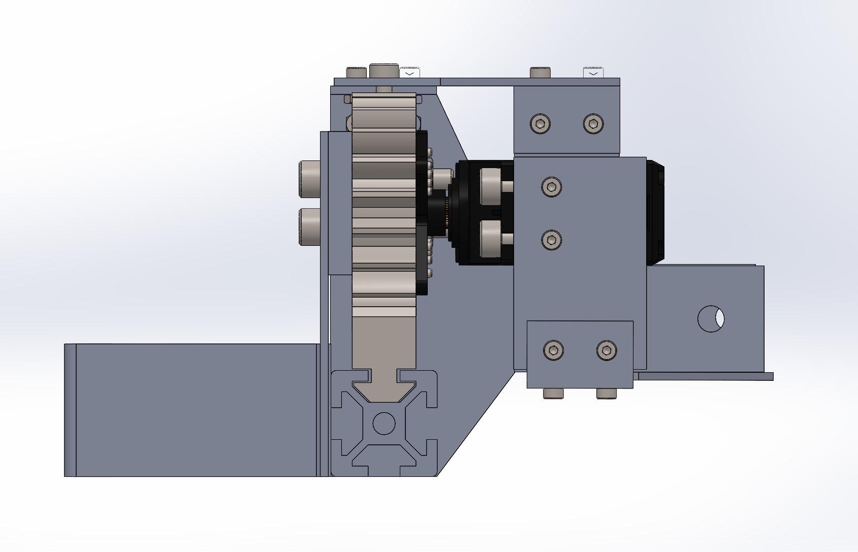
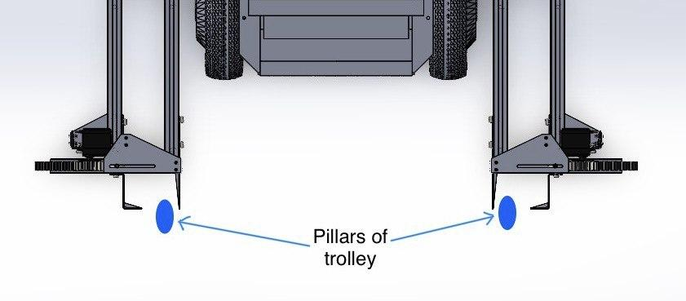
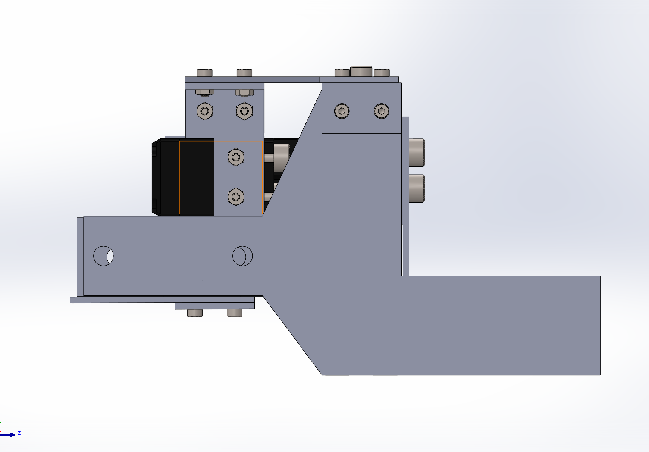
Final Gripper Cad
Side view (Right)
Docking view
Side view (Left)
Rack follows the cross-sectional pattern of aluminium extrusion
Servo and Pinion positioned at the end to allow for larger opening
A slot mechanism was added on the top to guide movement of rack
Sliding mechanism added to the jaws to ensure the pillars slide into place.

Slide 12

Final Gripper CAD
Operation video

Slide 13


Frame Selection
Selected Design
Frame 2
Reasons for selection
Enhanced structural support and robustness from the additional row of rods used and implementation of corner brackets
Improved stability with the usage of all AMR’s mounting holes for overall even load distribution
Scalable design which allows flexibility of design changes with the utilization of all AMR’s mounting points.

Slide 14
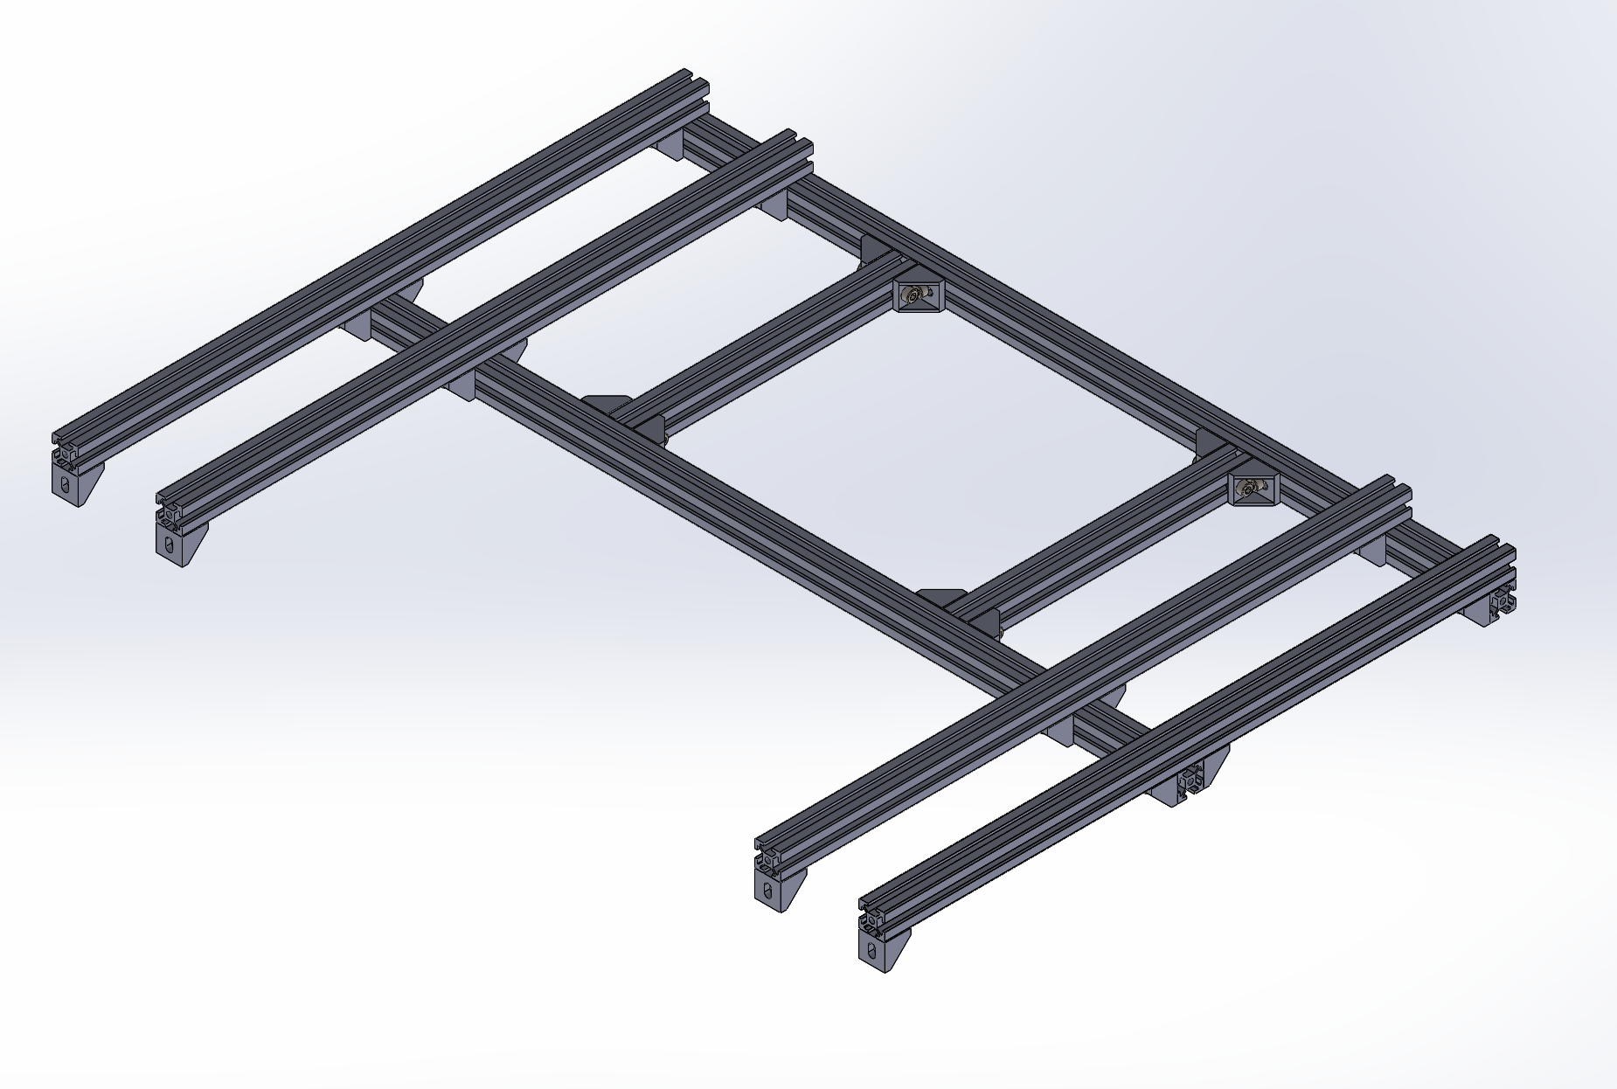
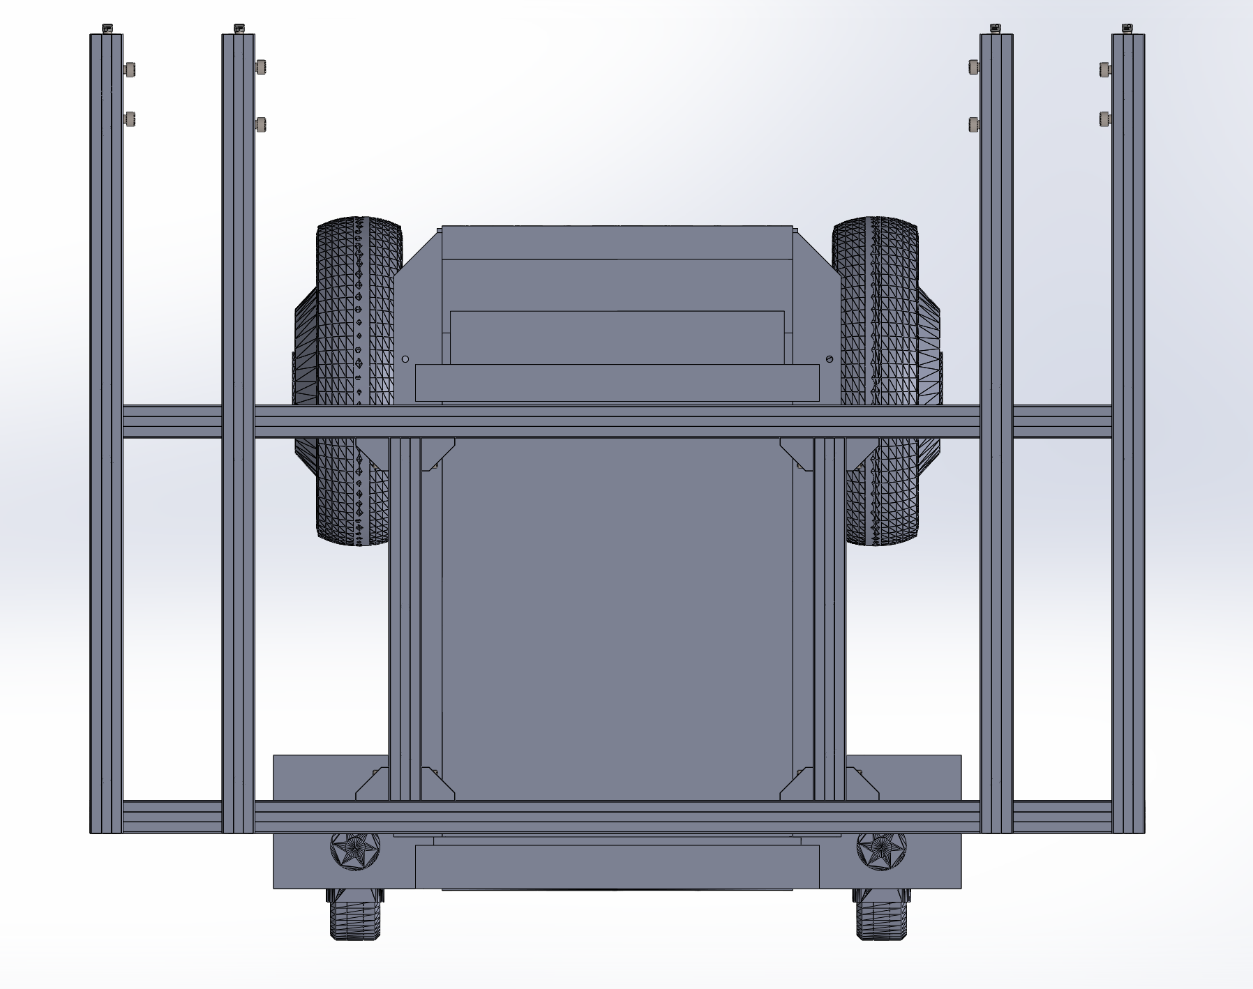
Final Frame Cad
Isometric view
Top view

Slide 15
Design Analysis (Weighted Decision Matrix)
Criteria | Weight | Linear Actuator | 2 Moveable Jaw | Rack and Pinon
Strength | 0.4 | 2 | 3 | 5
Toughness | 0.25 | 1 | 4 | 3
Stability | 0.25 | 3 | 3 | 2
Simplicity | 0.1 | 4 | 2 | 5
Total Weighted Score | 1 | 2.2 | 3.15 | 4.2

Slide 16
Prelim BOM List (Support Frame)
Item No. | Description | Qty
1. | Corner Bracket | 24
2. | Aluminium Extrusion (485 mm) | 4
3. | Aluminium Extrusion (640 mm) | 2
4. | Aluminium Extrusion (220 mm) | 2
5. | M5x10m Hex Cap Screw | 48
6. | M5x10m Nut | 48

Slide 17
Prelim BOM List (Gripper)
Item No. | Description | Qty
1. | TowerPro MG996R Servo Motor | 2
2. | Bottom Rectangular Rack | 2
3. | Spur Gear | 2
4. | Gliding Rail | 2
5. | 2 Moveable Jaw | 2
6. | 2 Dead Jaw | 2

Slide 18

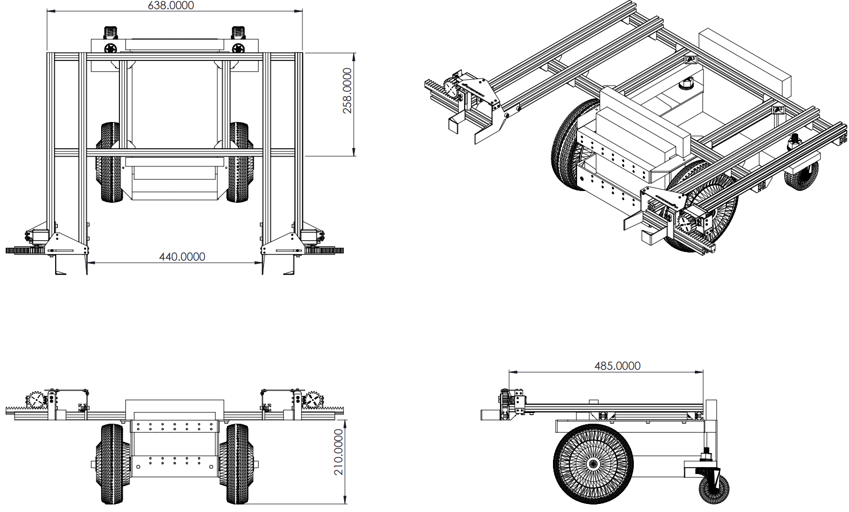

Final AMR Design
All measurements in mm

Slide 19
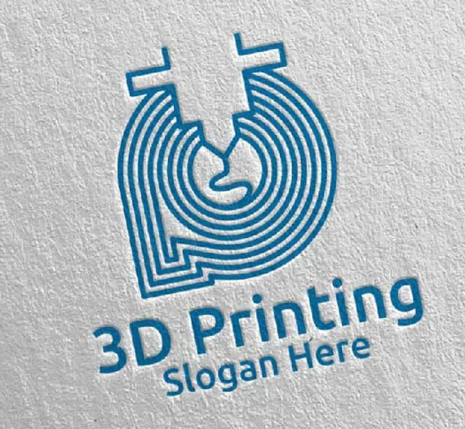

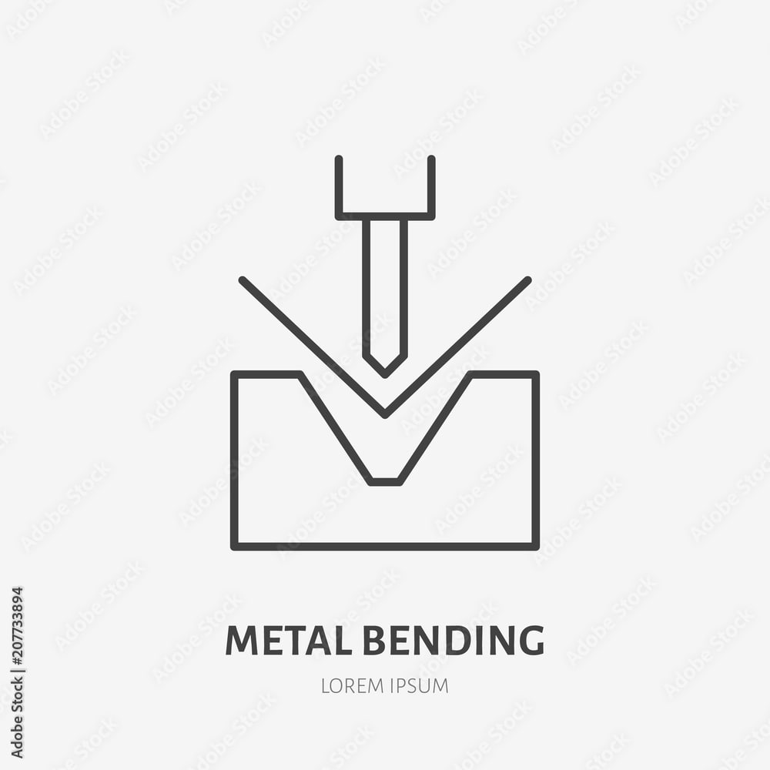

Fabrication Methods
and cutting
Used for
Spur Gear
Bottom Rack
Gliding Rail
Sliding Function on walls
Used for
Construction of support frame
Construction of gripper components
Used for
Cutting of aluminum extrusion and gliding rail
Cutting of moveable and dead jaw
Bending of moveable jaw

Slide 20
Thank You

